Slide 1
NP IOC Pilot
Surbana Jurong 24K

Slide 2
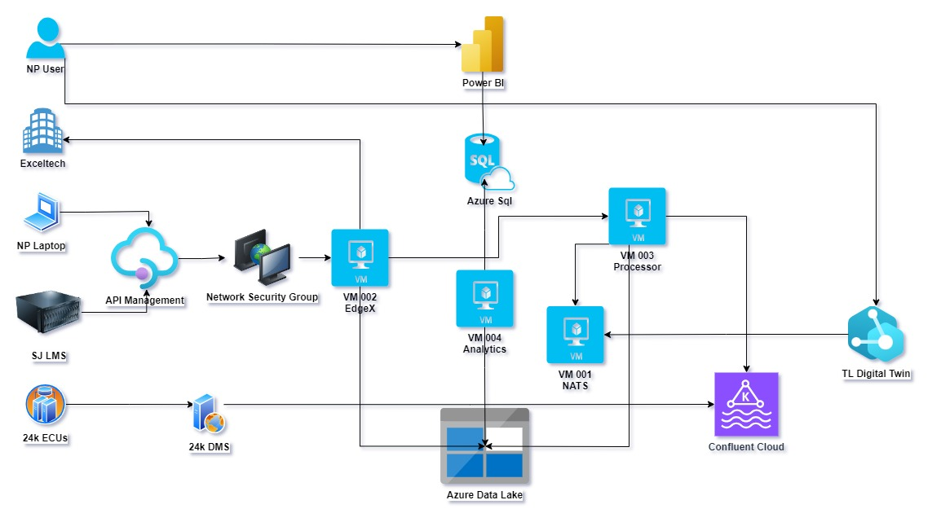
Deployment Architecture

